Slide 1
Grafică asistată de calculator
Laborator – Grigore Ionuț

Slide 2
Laboratory 5
Control What
Images to Generate
in Diffusion Models

Slide 3
Lab Overview
01
02
Embedding Inputs
U-Net from Scratch
Transform time steps and class labels into vector embeddings for the U-Net
Construct the encoder, decoder and skip connections from scratch — understanding each piece.
03
04
Classifier-Free Guidance
The DDPM Process
Train one model to work both with and without conditioning, enabling controlled generation.
Code the forward (noising) and reverse (denoising) diffusion processes from scratch.
05
06
Training the Model
Generating & Evaluating
Run 20 epochs on Fashion MNIST.
Generate images for each class and explore how the guidance strength controls quality vs diversity.

Slide 4
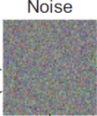
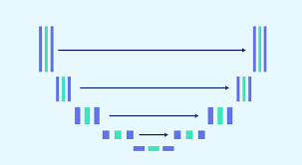
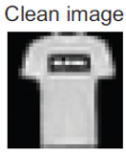





Context — What Problem Are We Solving?
Lab 4 — What we had
Lab 5 — What we want
skip connections
many steps...
skip connections
many steps...
encoder
decoder
encoder
decoder
▸ A diffusion model that generates clothing images
▸ The model randomly picks one of 10 categories
▸ Condition the model on a class label
▸ No way to say "generate a sandal" or "generate a coat"
▸ Ask for a specific item → get that item
▸ The U-Net was a black box from the diffusers library
▸ Build the U-Net from scratch to understand it
This lab is the foundation for text-to-image generation — in later labs, the class label is replaced by a text prompt.

Slide 5
Section 1
Different Components
of a Denoising U-Net

Slide 6
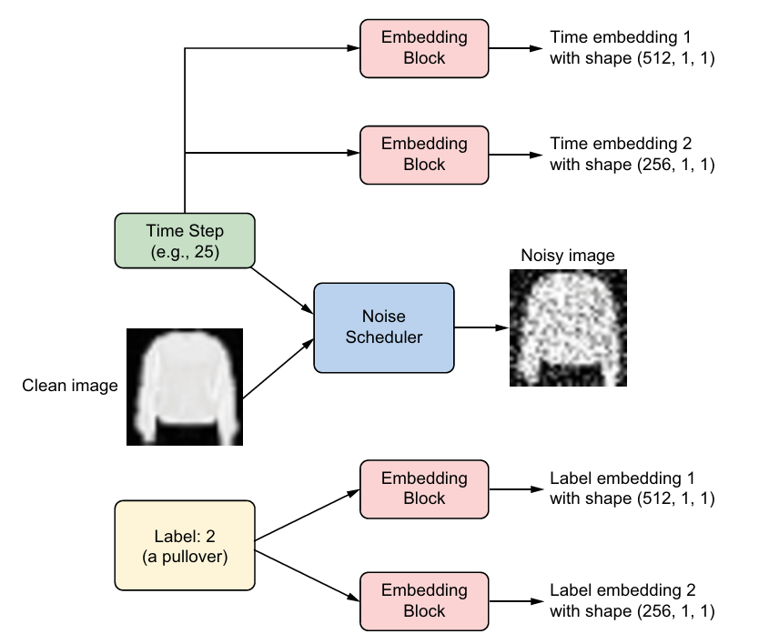

Time Step & Label Embedding
class EmbedLayer(nn.Module):
def __init__(self, input_dim, emb_dim):
...
# ── Time embeddings ──────────────────────────────────────────────────
timeembed1 = EmbedLayer(1, 512) # input: 1 scalar → 512 dim
timeembed2 = EmbedLayer(1, 256) # input: 1 scalar → 256-dim
t = torch.tensor([25]).long() / 1000 # normalise to [0, 1]
temb1 = timeembed1(t).view(-1, 512, 1, 1)
temb2 = timeembed2(t).view(-1, 256, 1, 1)
# ── Label embeddings ─────────────────────────────────────────────────
n_classes = 10
labelembed1 = EmbedLayer(n_classes, 512)
labelembed2 = EmbedLayer(n_classes, 256)
label = torch.tensor([2]).long()
# ... other details ...
lemb1 = labelembed1(c).view(-1, 512, 1, 1)
lemb2 = labelembed2(c).view(-1, 256, 1, 1)

Slide 7
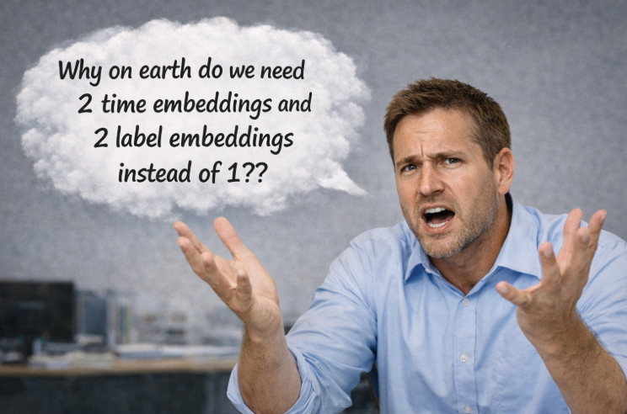

Slide 8
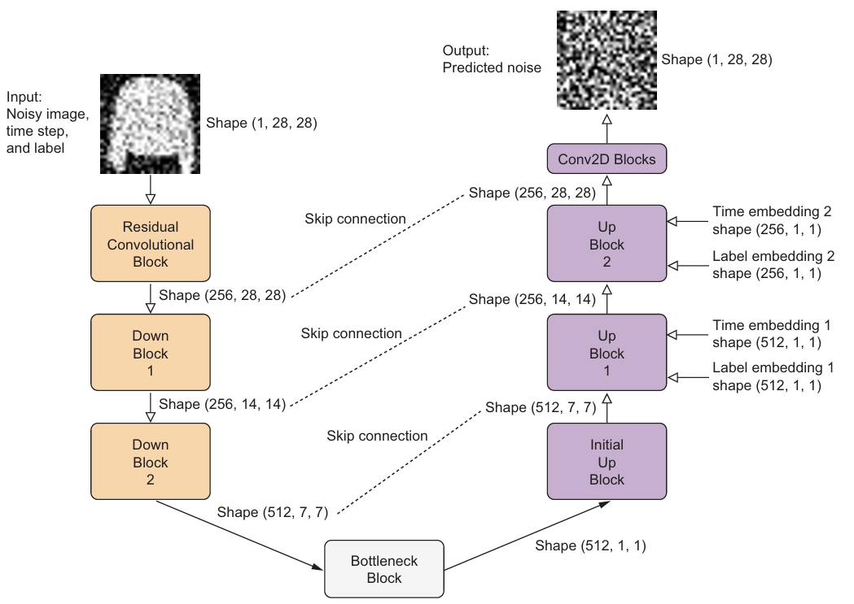


This is the U-Net model

Slide 10
Label Embedding & Classifier-Free Guidance
Tells the U-Net which clothing item to generate — and sometimes deliberately hides that information.
Label Embedding
Classifier-Free Guidance (CFG)
▸ Labels 0–9 are converted to a one-hot vector (10 values, all 0 except a single 1).
▸ Introduced by Ho & Salimans (2022).
▸ This vector passes through EmbedLayer, giving a (B, 512, 1, 1) tensor.
▸ During training: label is hidden with 10% probability → model also learns unconditional generation.
▸ The label embedding is multiplied with the decoder feature maps, steering image generation.
▸ At inference: blend conditional + unconditional predictions using guide_w parameter.
CFG Sampling Formula
ε_final = (1 + guide_w) × ε_conditional − guide_w × ε_unconditional
Effect of guide_w
TL;DR:
When the value of guide_w is large, the generated images match the labels well but lack diversity.
When guide_w is small, you see more diversity, but the generated images may not match the labels closely.

Slide 11

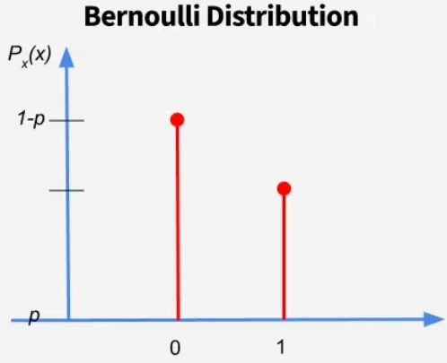
During Training …
label = 3
[0, 0, 0, 1, 0, 0, 0, 0, 0, 0]
- one hot encoding
90%
10%
mask
[1, 1, 1, 1, 1, 1, 1, 1, 1, 1]
mask
[0, 0, 0, 0, 0, 0, 0, 0, 0, 0]
c = onehot × mask
[0, 0, 0, 1, 0, 0, 0, 0, 0, 0]
c = onehot × mask
[0, 0, 0, 0, 0, 0, 0, 0, 0, 0]
Keep the label information
Discard the label information

Slide 12



During Inference …
Same but duplicated
Resulted clean image
one hot encoding -
label = 3
[0, 0, 0, 1, 0, 0, 0, 0, 0, 0]
[0, 0, 0, 1, 0, 0, 0, 0, 0, 0]
mask
[1, 1, 1, 1, 1, 1, 1, 1, 1, 1]
[0, 0, 0, 0, 0, 0, 0, 0, 0, 0]
label = 3
[0, 0, 0, 1, 0, 0, 0, 0, 0, 0]
[0, 0, 0, 0, 0, 0, 0, 0, 0, 0]
c = onehot × mask
skip connections
ε_final = (1 + guide_w) × ε_conditional − guide_w × ε_unconditional
encoder
decoder
Predicted noise to be removed:
conditional
unconditional
final
… and so on many steps …

Slide 13
Try to focus on the big picture and not get lost in details

Slide 14
Section 2
Building and Training
the Denoising U-Net

Slide 15
UnetDown & UnetUp
The UnetDown halves resolution; the UnetUp doubles it back:
UnetDown — downsampling
class ResidualConvBlock(nn.Module):
def __init__(self, in_ch, out_ch,...):
...
class UnetDown(nn.Module):
def __init__(self, in_ch, out_ch):
...
UnetUp — upsampling
class UnetUp(nn.Module):
def __init__(self, in_ch, out_ch):
...

Slide 16
UnetDown & UnetUp
The UnetDown halves resolution; the UnetUp doubles it back:

Slide 17
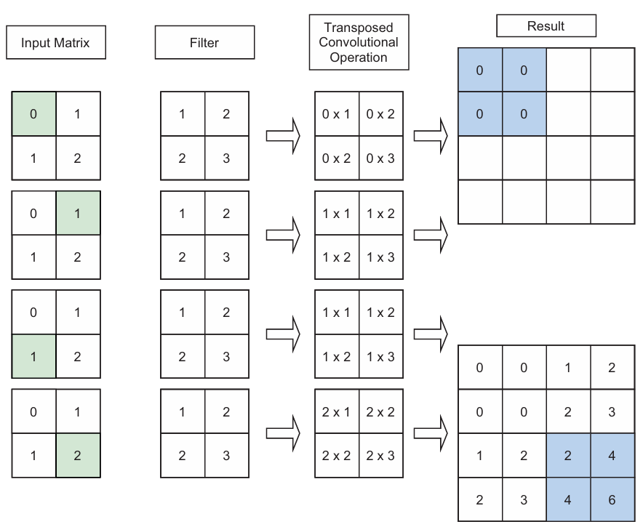
UnetDown & UnetUp
The UnetDown halves resolution; the UnetUp doubles it back:

Slide 18
Full U-Net Forward Pass
Noisy image + label + timestep → predicted noise:
class Unet(nn.Module):
def __init__(self, in_channels, ..., n_classes=10):
...
def forward(self, noisy_image, label, timestep, ...):
...
return predicted_noise
NOTE:
Details are omitted here to focus on the big picture.
The implementation follows the diagram step by step—line by line.
Feel free to ask if anything is unclear.

Slide 19
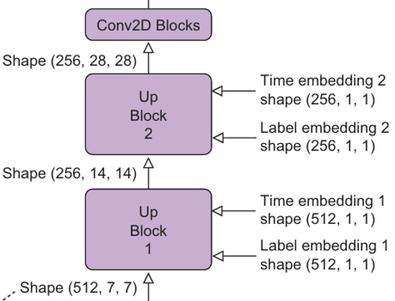





How Embeddings Are Injected into the Decoder
Injection formula: label_embedding × input_feature + time_embedding
…
…

Slide 20


Slide 21
How Embeddings Are Injected into the Decoder
Injection formula: label_embedding × input_feature + time_embedding
Label embedding — multiplicative
Time embedding — additive
▸ Multiplies the feature map channel-by-channel.
▸ Added directly to the feature map.
▸ Acts like an attention gate — amplifies channels relevant to the target class and suppresses others.
▸ Shifts the decoder's "noise estimate" based on how much noise is present at this timestep.
▸ Example: for label 'coat', coat-related features are boosted.
▸ Example: at t=900 (very noisy), the shift is large; at t=10 (almost clean), it's small.
▸ Without it, the same decoder weights would try to denoise a barely-noisy image (t=10) and a nearly-pure-noise image (t=900) identically — the additive signal is what tells them apart.

Slide 22
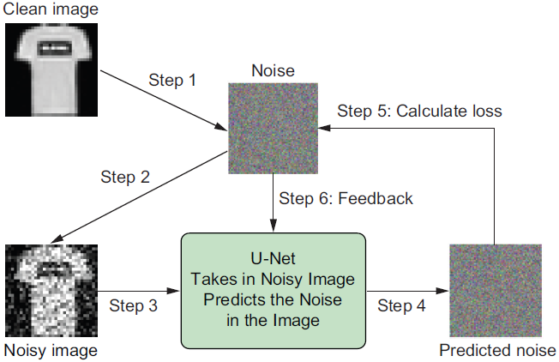
The DDPM Scheduler: Adding Noise & Calculating Loss
The DDPM Scheduler wraps a noise schedule and 2 functions:
add noise — does the same thing as linear and cosine scheduler
calculate loss — computes loss between the true noise ε that was added and the noise predicted by the U-Net

Slide 23
The DDPM Scheduler: Adding Noise & Calculating Loss
class DDPM(nn.Module):
def __init__(self, model, ...):
...
def forward(self, x, c):
# 1. Pick a random timestep for each image
_ts = torch.randint(1, self.n_T + 1, (x.shape[0],)).to(self.device)
# 2. Sample noise and create noisy image
noise = torch.randn_like(x)
x_t = (self.sqrtab[_ts, None, None, None] * x
+ self.sqrtmab[_ts, None, None, None] * noise)
# 3. CFG mask (10 % unconditional)
context_mask = torch.bernoulli(
torch.zeros_like(c) + self.drop_prob).to(self.device)
# 4. Return MSE between true noise and predicted noise
return self.loss_mse(noise,
self.model(x_t, c, _ts / self.n_T, context_mask))

Slide 24
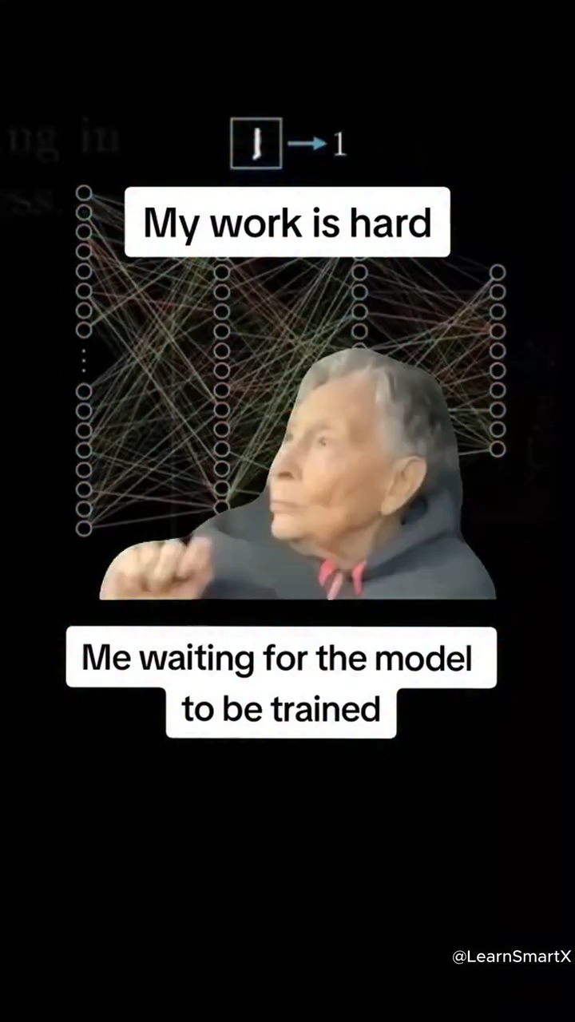
Training the CFG Diffusion Model
scaler = torch.amp.GradScaler("cuda")
for ep in range(n_epoch):
ddpm.train()
...
for x, c in tqdm(dataloader):
x, c = x.to(device), c.to(device)
with torch.amp.autocast("cuda"): # mixed precision (fp16/fp32)
loss = ddpm(x, c) # DDPM MSE loss
optim.zero_grad()
scaler.scale(loss).backward()
scaler.step(optim)
scaler.update()
...
optim.step() # Backpropagation
torch.save(model.state_dict(), "files/conditional.pth") # save weights

Slide 25
Section 3
Generating Images
with the Trained
Conditional Model

Slide 26
During Inference …
Same but duplicated
Resulted clean image
one hot encoding -
label = 3
[0, 0, 0, 1, 0, 0, 0, 0, 0, 0]
[0, 0, 0, 1, 0, 0, 0, 0, 0, 0]
mask
[1, 1, 1, 1, 1, 1, 1, 1, 1, 1]
[0, 0, 0, 0, 0, 0, 0, 0, 0, 0]
label = 3
[0, 0, 0, 1, 0, 0, 0, 0, 0, 0]
[0, 0, 0, 0, 0, 0, 0, 0, 0, 0]
c = onehot × mask
skip connections
ε_final = (1 + guide_w) × ε_conditional − guide_w × ε_unconditional
encoder
decoder
Predicted noise to be removed:
conditional
unconditional
final
… and so on many steps …

Slide 27
CFG Sampling
Run two passes per step (cond + uncond) and interpolate with guide_w:
@torch.no_grad()
def sample(ddpm, model, guide_w, ...):
...
# CFG combination
eps = (1 + guide_w) * eps_cond - guide_w * eps_uncond
...
CFG Sampling Formula
ε_final = (1 + guide_w) × ε_conditional − guide_w × ε_unconditional
Effect of guide_w
TL;DR:
When the value of guide_w is large, the generated images match the labels well but lack diversity.
When guide_w is small, you see more diversity, but the generated images may not match the labels closely.

Slide 28
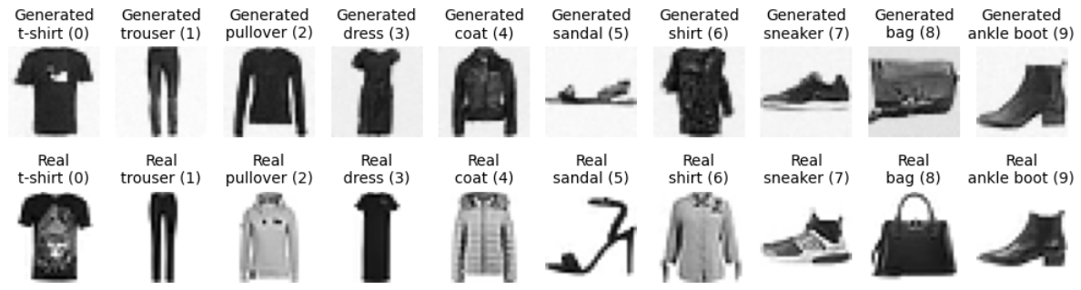
CFG Sampling
guide_w = 2
Effect of guide_w
TL;DR:
When the value of guide_w is large, the generated images match the labels well but lack diversity.
When guide_w is small, you see more diversity, but the generated images may not match the labels closely.

Slide 29
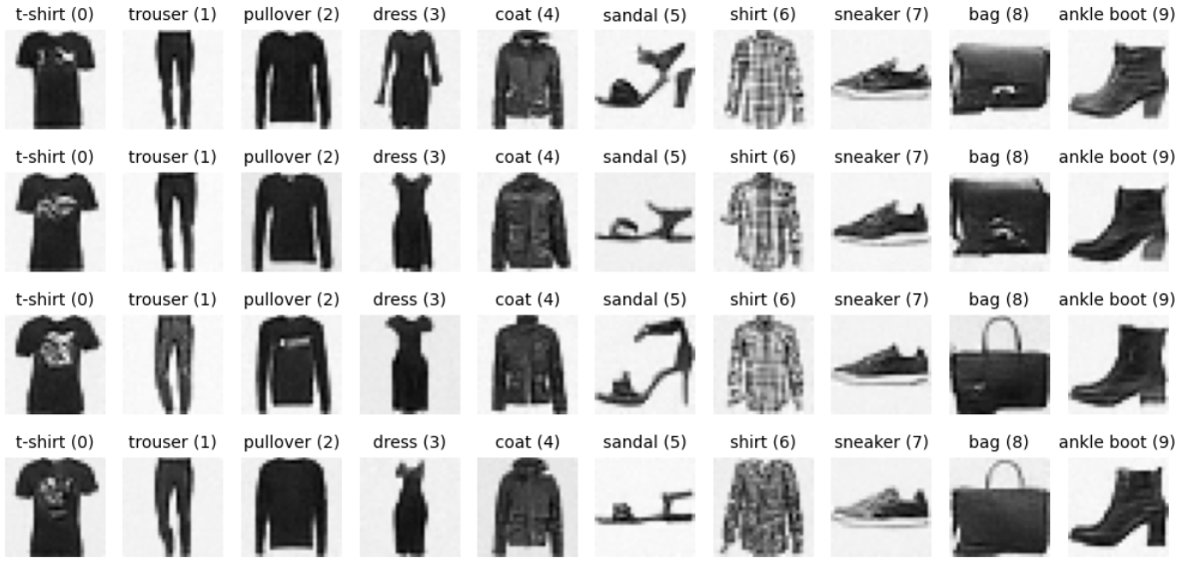
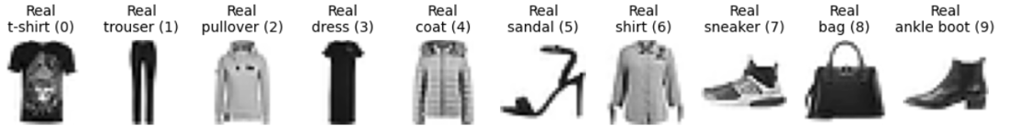
CFG Sampling
guide_w = 5
Effect of guide_w
TL;DR:
When the value of guide_w is large, the generated images match the labels well but lack diversity.
When guide_w is small, you see more diversity, but the generated images may not match the labels closely.

Slide 30
Lab Exercises
1
Time Embedding with t = 42
Suppose the time step value is 42 . Modify the code for creating the two time embeddings to create two time embeddings with embedding dimensions 512 and 256 , respectively. Then, print out the shape of the two time embeddings.
Hint: t = torch.tensor([42]).long() / 1000 → pass through both EmbedLayer instances.
2
Label Embedding for 4 Samples
Suppose there are four labels in the batch with values 1, 3, 5 and 7, respectively. Modify the code for generating label embeddings to create two label embeddings. Then, print out the shape of the two label embeddings.
Hint: Expected: (4, 512, 1, 1) and (4, 256, 1, 1). Don't forget the Bernoulli mask.
3
Low-Guidance Generation (guide_w = 1)
Generate 40 images by setting the guidance parameter to 1. Then, plot the generated images in a 4×10 grid.
Hint: Lower w = more diverse outputs but weaker label adherence.

Slide 31
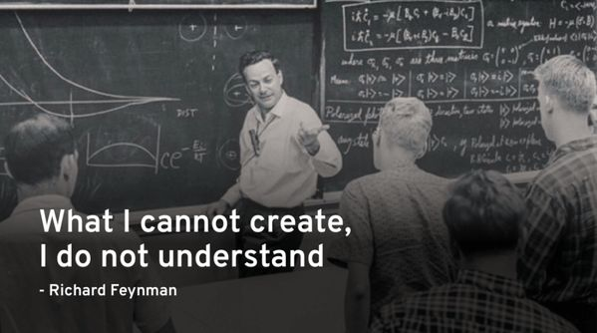

Slide 32
Ex 1
Time Embedding with t = 42
❓ Suppose the time step value is 42 . Modify the code for creating the two time embeddings to create two time embeddings with embedding dimensions 512 and 256 , respectively. Then, print out the shape of the two time embeddings.
timeembed1 = EmbedLayer(1, 512) # first embedding: 512-dimensional
timeembed2 = EmbedLayer(1, 256) # second embedding: 256-dimensional
timesteps = torch.tensor([42]).long() # t = 42
t = timesteps / 1000 # normalise → 0.042
temb1 = timeembed1(t).view(-1, 512, 1, 1) # reshape to (B, 512, 1, 1)
temb2 = timeembed2(t).view(-1, 256, 1, 1) # reshape to (B, 256, 1, 1)
print("Shape of first time embedding:", temb1.shape)
print("Shape of second time embedding:", temb2.shape)
Output Shape of first time embedding: torch.Size([1, 512, 1, 1])
Shape of second time embedding: torch.Size([1, 256, 1, 1])
💡 EmbedLayer is already defined in laboratory. Just copy it ☺

Slide 33
Ex 1
Time Embedding with t = 42
❓ Suppose the time step value is 42 . Modify the code for creating the two time embeddings to create two time embeddings with embedding dimensions 512 and 256 , respectively. Then, print out the shape of the two time embeddings.
Why do the shapes look like this, and what does each dimension mean?
Dimension 1 → 1
Batch size
There is only one sample in the batch (we passed a single timestep t = 42).
Dimension 2 → 512 or 256
Embedding size
The EmbedLayer projects the scalar input into a 512- or 256-dimensional vector. Larger embeddings carry more information but cost more memory.
Dimensions 3 & 4 → 1, 1
Spatial placeholder
These two trailing 1s allow the embedding to broadcast over the spatial dimensions (H×W) of any feature map in the decoder — no extra code needed.

Slide 34
Ex 2
Label Embedding for 4 Samples
❓ Suppose there are four labels in the batch with values 1, 3, 5 and 7, respectively. Modify the code for generating label embeddings to create two label embeddings. Then, print out the shape of the two label embeddings.
n_classes = 10
contextembed1 = EmbedLayer(n_classes, 512) # label → 512-dim embedding
contextembed2 = EmbedLayer(n_classes, 256) # label → 256-dim embedding
label = torch.tensor([1, 3, 5, 7]).long() # batch of 4 labels
# Step 1 – Bernoulli mask (10 % probability of hiding the label → CFG)
context_mask = torch.bernoulli(torch.zeros_like(label) + 0.1) # shape: (4,) values: 0 or 1
# Step 2 – One-hot encode (each label → 10-value vector)
onehot = F.one_hot(label, num_classes=n_classes).float() # (4, 10)
# Step 3 – Apply mask (masked rows become all -1 → embedding ignores them)
context_mask = context_mask[:, None] # (4, 1)
context_mask = context_mask.repeat(1, n_classes) # (4, 10)
context_mask = (-1 * (1 - context_mask)) # 0→-1, 1→0
c = onehot * context_mask # (4, 10)
# Step 4 – Embed and reshape
cemb1 = contextembed1(c).view(-1, 512, 1, 1) # (4, 512, 1, 1)
cemb2 = contextembed2(c).view(-1, 256, 1, 1) # (4, 256, 1, 1)
print("Shape of first label embedding:", cemb1.shape)
print("Shape of second label embedding:", cemb2.shape)

Slide 35
Ex 2
Label Embedding for 4 Samples
❓ Suppose there are four labels in the batch with values 1, 3, 5 and 7, respectively. Modify the code for generating label embeddings to create two label embeddings. Then, print out the shape of the two label embeddings.
Output Shape of first label embedding: torch.Size([4, 512, 1, 1])
Shape of second label embedding: torch.Size([4, 256, 1, 1])
💡 EmbedLayer is already defined in laboratory. Just copy it ☺
Output shapes explained
4
Batch size (labels 1, 3, 5, 7 → 4 samples).
512 / 256
The EmbedLayer output dimension — chosen to match the U-Net decoder feature channels.
1, 1
Spatial broadcast dimensions — same as in Exercise 1.

Slide 36
Ex 3
Low-Guidance Generation (guide_w = 1)
❓ Generate 40 images by setting the guidance parameter to 1 . Then, plot the generated images in a 4×10 grid.
n_sample = 4 * n_classes # 4 × 10 = 40 images
# Load trained model (same as in the lab)
model.load_state_dict(torch.load("files/conditional.pth", weights_only=True, map_location=device))
ddpm.eval()
# Generate with LOW guidance (guide_w = 1)
x_gen, _ = sample(ddpm, model, n_sample, (1, 28, 28),
device, guide_w=1) # ← only change vs lab
# Plot in a 4 × 10 grid
from matplotlib import pyplot as plt
plt.figure(figsize=(10, 5), dpi=100)
for i in range(40):
plt.subplot(4, 10, i + 1)
plt.imshow(x_gen[i].cpu().permute(1, 2, 0) / 2 + 0.5, cmap="binary")
plt.axis("off")
c = i % 10
plt.title(f"{text_labels[c]} ({c})", fontsize=10)
plt.tight_layout()
plt.show()

Slide 37
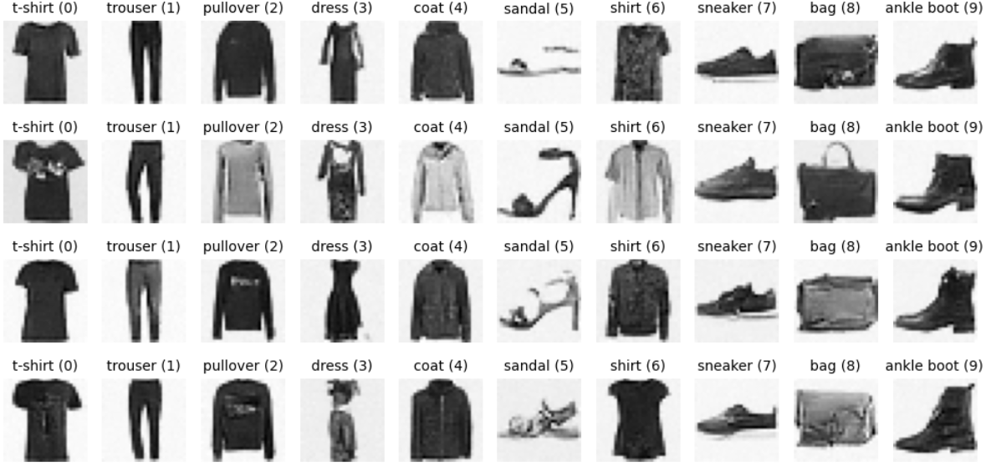
Ex 3
Low-Guidance Generation (guide_w = 1)
❓ Generate 40 images by setting the guidance parameter to 1 . Then, plot the generated images in a 4×10 grid.

